Slide 1
The National Traveller and Roma Inclusion Strategy (NTRIS)
Margaret Whelan,
Traveller and Roma Inclusion Unit, Equality Division

Slide 2

2014 Review
Assessment of the effectiveness of the structures in place for consultation with and delivering better outcomes to the Traveller & Roma Communities.
2014 Report of Ms. Emily Logan, former Ombudsman for Children, under Section 42 of the Garda Síochána Act 2005 into the circumstances surrounding the removal of two Roma children from their families.

Slide 3
2014 Review – contd.
Assessment at national level made a number of recommendations aimed at improving effectiveness in the structures and progressing strategy to promote and support the integration of the Traveller and Roma communities.
Implementation during 2015:
  the establishment of a new National Traveller & Roma Integration Strategy (NTRIS) Steering Group to monitor the implementation of the NTRIS.
    To ensure that a renewed emphasis is given across Government to making progress on implementing NTRIS.
    First meeting held on 1/4/15.

Slide 4
National Traveller and Roma Inclusion Strategy (NTRIS)
Ireland’s NTRIS was developed under the EU Framework for the Implementation of National Roma integration Strategies up to 2020.
  Member States were invited to prepare, update or develop their national Roma inclusion strategies taking into account their specific circumstances with particular reference to the key priority area – access to quality education, employment, healthcare, housing and anti-discrimination.
Ireland reports annually to the European Commission on progress made.
During 2015, a wide-ranging consultation process aimed at reviewing Ireland’s existing NTRIS with a view to making whatever changes are appropriate by early 2016.

Slide 5
2014 Review – contd.
The Traveller Inter-Agency Process.........

Slide 6
High Level Group on Traveller Issues (HLG)
2003 - HLG was established as a sub-committee of the Senior Officials Group on Social Inclusion reporting to the Cabinet Committee on Social Inclusion. Now the Senior Officials Group/Cabinet Committee on Social Policy (SOGSP)
Remit: To “ensure that the relevant statutory agencies involved in providing the full range of services to Travellers, would focus on improving the integrated practical delivery of such services”.

Slide 7
High Level Group on Traveller Issues (HLG) – contd.
HLG Report 2006:
  Aim: of finding ways of securing better outcomes for Travellers and improve the use of the considerable resources, allocated across Government Departments for Traveller-specific measures.
  Emphasised: the view that inter-agency cooperation between statutory bodies is the cornerstone of enhanced service delivery, identifying it as a priority issue.
  Stressed: the importance of community involvement.
  Recommended that local authorities develop a strategic plan to implement a coordinated inter-agency approach.

Slide 8
High Level Group on Traveller Issues (HLG) – contd.
Central recommendations of the HLG Report:
To establish a coordinated inter-agency strategy for the delivery of services and supports for Travellers in all cities and counties with a Traveller population.
To actively promote effective consultation with Travellers at national and local level in helping to deliver the inter-agency approach, and in facilitating better communications, including conflict resolution; and
To ensure that law enforcement is included as part of the proposed integrated approach.

Slide 9
Traveller Inter-Agency Fund
Purpose: To give additional impetus to the work of the TIGs in developing the mechanics of better service delivery.
Established: To support projects targeting the Traveller community, delivered on an inter-agency basis.
Actions aided by the Fund addressed a wide range of Traveller issues, including
  Family health education;
  School transition, after school support and family support around schooling and children’s health;
  Adult development, often with a separate focus for men and women;
  Networking and building of Traveller representative capacity;
  Youth development;
  Employment and training for employment;
  Multi-cultural awareness training and community integration;
  Accommodation and tenancy support.

Slide 10
Traveller Inter-Agency Fund – contd.
A major focus of the Fund was to stimulate inter-agency activity.
Innovation was prioritised in the guidelines and the project assessment procedures. Innovation took place, primarily, through the establishment and operation of the new inter-agency structures as well as introducing new ways of conducting intra-group communication and embedding accountability.
The collaborative process necessary to design applications and deliver projects brought greater visibility of local Traveller issues and of their inter-dependence.

Slide 11
Traveller Inter-Agency Fund – contd.
Benefits:
The requirement of the Fund that applications be for priority actions linked to the county Traveller strategy stimulated those TIGs that had not engaged with the new process to formulate a strategy and commence cross-organisational communication.
The requirement for a Traveller presence on project steering groups led to better engagement with local Traveller representative groups.
Several promising projects were initiated.
The new focus in Government strategy on developing local structures capable of progressing service delivery issues to Travellers was given greater visibility.

Slide 12
Traveller Inter-Agency Fund – contd.
Limitations:
Inability to sustain actions long enough to make a meaningful social impact – projects which had no prospect of continuation or of mainstreaming could be counter-productive.
1 year timescale for projects was found to be too short to definitively establish project value. Suggested minimum project length has generally been between 3 and 7 years but, for greatest impact, should be related to the stage of Traveller life-cycle at which it is targeted, i.e. Early childhood development → Family support around schooling → School transition → After school support → Youth development → Preparing for employment → Employment → Multi-cultural awareness training → Horse project → Adult training and networking....
Failure to acquire funding led to disillusionment with the inter-agency process in some cases.
Failure on the part of individual local organisations to have their projects prioritised for application to the Fund by a TIG can contribute to diminished participation. Compounded where outcomes are poor from a chosen project which secured funding.

Slide 13
Traveller Inter-Agency Fund – contd.
Sustainability:
There appeared to be a strong connection between sustainability of projects and sustainability of general TIG activity.
Collaborating around actions is the cornerstone of inter-agency work and for several TIGs funded collaborative projects were the main binding force.
In 2011, a question arose as to whether there was any point in continuing to meet, in the absence of such projects.
The need for achieving successes regularly, however small, was cited as a primary driving force of inter-agency activity by many TIG members.

Slide 14
Traveller Inter-Agency Fund – contd.
National Obstacles to Mainstreaming Projects:
The stimulating effect of the Traveller Fund on inter-agency work was perceived by many TIG members as being partially undermined by the absence of an adequate national strategic framework.
The crux of the matter was that most agencies and Government departments, while encouraging pilot projects and expressing encouragement for inter-agency work, had not established a mainstreaming strategy for pilot projects and had not yet come to terms with the need for change in this respect.

Slide 15
Challenges Identified to TIG Process
Dissension between the statutory and community sectors and poor statutory sector participation.
Traveller Community divisions.
Maintaining organisational relationships, disagreements between those with a community development approach and those focused on prompt service delivery.
No dedicated person to undertake tasks such as convening meetings, minuting, progress evaluation and general administration.
Dependence for vitality on one committed person or a small number of such persons – high turnover of personnel in both community organisations and statutory agencies.

Slide 16
Challenges Identified to TIG Process – contd.
Uneven representation of relevant statutory organisations across TIGs.
City/County boundaries do not coincide with areas of operation of statutory agencies, regional sections of Govt departments, and areas of influence of community groups/voluntary organisations, let alone Traveller populations.
Continued operation of TIGs in the face of difficult accommodation and law & order issues.
Developing mutual understanding – intercultural understanding is a basic requirement for TIG participation. Inter-agency training, very often in relation to diversity, was one of the first actions undertaken by several TIGs

Slide 17
Key Factors for TIGs Success
Senior Involvement and National Support
  Senior personnel from key agencies. It was pointed out by Pobal in 2011 that while TIG members are expected to act and contribute to actions across the spectrum of thematic areas, there appears to be no framework for Government departments and statutory agencies to initiate the system adjustments necessary to support local inter-agency involvement, enable the cross-funding of inter-agency actions, and provide mainstreaming mechanisms for promising inter-agency actions. They clearly state the importance of national validation of TIG work, which would emanate from visible inter-agency collaboration at national level.
Commitment:
  Lack of commitment is sometimes evident from failure of agencies to make participants available for meetings or failure to provide a dedicated representative.
Training for Inter-Agency Work
The Importance of Open Communication and Equal Participation
Traveller Participation and Representation

Slide 18
TIG Regional Meetings 2014 – Challenges Identified
Health
  Mental Health issues
  Experienced TIG members have been reassigned on foot of the HSE reorganization and reduced staff within the county council.
Accommodation
  The accommodation issue can take over TIG meetings; a link is needed to the LTACC.
  Continued support is needed after families are housed – education around cultural behaviour, burning, waste disposal etc.
  Issue with Private Rented Homes - lack of supply.

Slide 19
TIG Regional Meetings 2014 – Challenges Identified – contd.
Education
  Difficulties in getting people/agencies to come to TIG meetings
  Illiteracy very high in the Traveller community
  TIGs were more active in the past – some reasons identified were withdrawal of funding, removal of visiting teachers and Traveller education centres, increased pressure on TIG members.
  Training initiatives seen as work and will only participate if paid to do so
  Youth-Reach encourages young Travellers to leave school
  Need for Horse management initiatives
  Peer pressure within the Traveller community for young people to be seen as adults, e.g. 'be a man', 'early marriage', leaving school early.

Slide 20
TIG Regional Meetings 2014 – Challenges Identified – contd.
Anti-Discrimination:
  Violent and anti-social behaviour in the Traveller community.
  Need for cultural competence training for service providers and the need to raise awareness regarding equality.
Employment
  Very high unemployment in the Traveller community
  Work experience in Private Sector non-existent
  Limited value of public sector offering temporary employment
  Insufficient focus in TIGs on enterprise and employment - attitudinal change needed
  Peer pressure within the Traveller community for young people to be seen as adults, e.g. 'be a man', 'early marriage', yet limited employment opportunities

Slide 21
TIG Regional Meetings 2014 – Challenges Identified – contd.
Strategic Direction
  Measures should be developed - what are we measuring? Quality of life?
  Should TIGs be renamed?
  Why should there be a separate plan for TIGs?
  TIGs need to have somewhere to report locally and nationally.
  TIGs need to have practical guidelines to follow and long-term goals needed.
  Statutory support for TIGs - clarity needed on how TIGs fit into new structures.
  Strategies tend to fall on implementation - need an implementation plan for new Framework.
  Funding needs to be ring-fenced across Departments.
  People are needed on the ground.

Slide 22
TIG Regional Meetings 2014 – Challenges Identified – contd.
Strategic Direction – contd.:
  Structures within Local Authorities are an issue impacting on how TIGs will engage, some TIG members come from the Community Development Sections of LAs while other TIGs are completely outside the Comm Dev Sections.
  Urgent need for engagement protocol for TIGs/LCDCs
  Difficulties in getting people/agencies to come to TIG meetings
  TIGs not meeting at all, due in some cases to staff shortages.
  Need for leadership/capacity building training for Travellers to better enable representatives engage with the TIG.

Slide 23
TIG Regional Meetings 2014 – Challenges Identified – contd.
Strategic Direction – contd.:
  Need to be take account of what Travellers want themselves and support them in that.
  Issue with HSE restructuring and change of personnel / Tusla - support services not in place
  There is a need for dedicated training resources for TIG members.
  Experienced TIG members have been reassigned on foot of the HSE reorganization and reduced staff within the county council.
  Given the disproportionate spread of members of the Travelling community across counties, is it worth regionalising the TIGs?

Slide 24
The Way Forward....
The Traveller Inter-Agency Process.....

Slide 25
Local Government Reform
The Department of Environment, Community and Local Government delivers the ‘Social Inclusion and Community Activation Programme’ (SICAP) which aims to tackle poverty, social exclusion and long-term unemployment through local engagement and partnership between disadvantaged individuals, community organisations and public sector agencies. A key principle of the programme is to prioritise marginalised people and social groupings within the most disadvantaged communities, by targeting those furthest from access to education, training and employment and those at highest risk of social exclusion.
Travellers and Roma are a named target group of the SICAP and some actions undertaken may be traveller specific, while others may include a number of target groups including Travellers.

Slide 26
Local Government Reform – contd.
The range of activities carried out in co-operation/collaboration with local groups, Traveller organisations, state agencies to provide supports to Travellers, typically include:
- access to further education and training
- school retention activities
- provision of tailored education and training
- primary health care and wellbeing programmes
- interagency collaboration
- after-schools and youth projects
- family supports
- community development supports
- employment/self-employment supports
Under the LCDP, Roma are not a named target group but do benefit from LCDP activities under the 'Non-Irish nationals', although this grouping is much broader than Roma.

Slide 27
Proposed Traveller Inter-Agency Funding scheme
A stream of funding for Traveller Community Development Projects was provided via the predecessor programme to SICAP, the Local and Community Development Programme (LCDP) until early 2015.
The National Traveller Partnership (NTP) under the auspices of Pavee Point Traveller and Roma Centre co-ordinated the delivery of the LCDP in partnership with 14 Traveller Community Development projects.
In early 2015 that funding line transferred to the Department of Justice and Equality as part of a proposed revised Traveller Inter-Agency Fund which will form part of a new National Strategic Framework.
Discussions are ongoing with the NTP regarding the shape this may take and includes a proposal for Regional Support Groups to support the projects undertaken by TIGs.

Slide 28
Proposed TIG National Strategic Framework
The framework was developed in an effort at addressing the challenges identified and to support TIGs in implementing local strategies based on international, national, regional and local priorities, all in consultation with Local Community Development Committees (LCDCs) in each Local Authority areain relation to the Local Economic & Community Plan.
It sees TIGs submitting their Strategies to the Traveller and Roma Inclusion Unit for agreement and approval of funding requests, and culminates in the provision of annual reports to TPD for feedback to policy development and the NTRIS Steering Group.

Slide 29
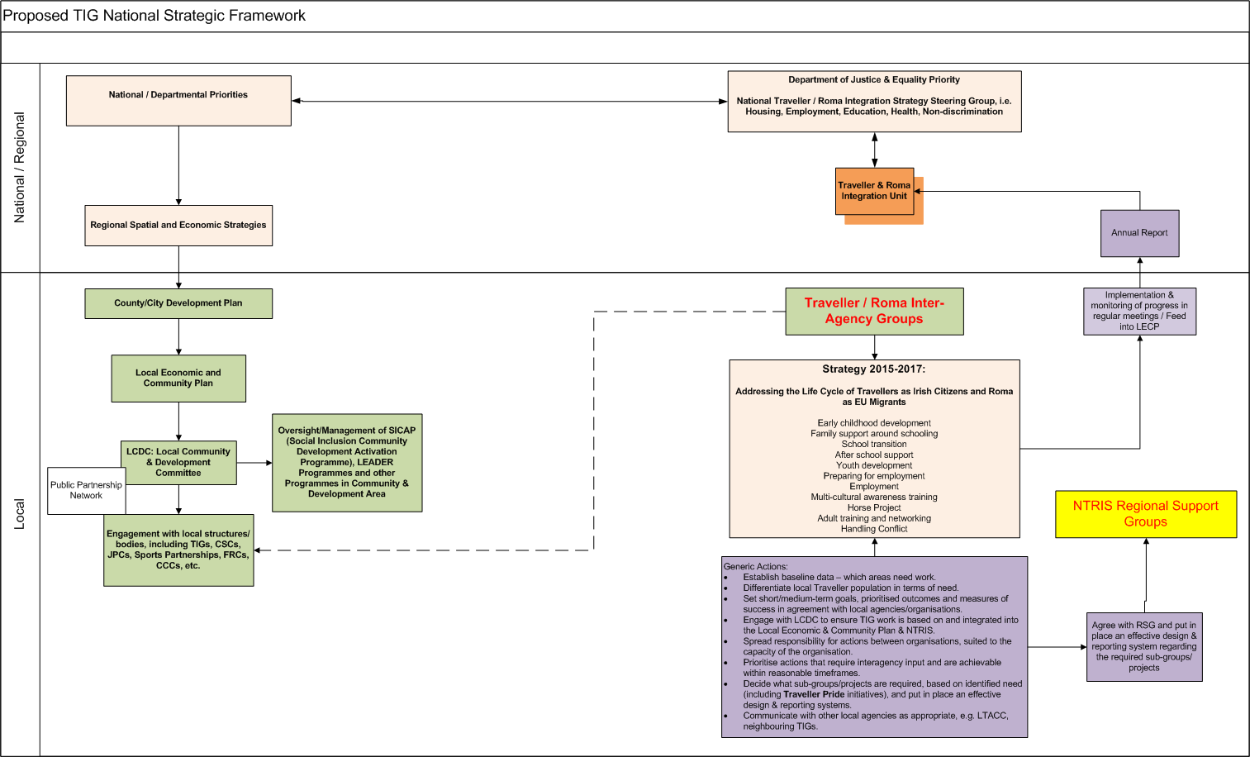
Proposed TIG National Strategic Framework

Slide 30
Summary
Cyclical process:
  The work of TIGs is not done in isolation... Should be strategic, informed by and in turn informing the work at national level, i.e. The National Traveller and Roma Inclusion Strategy Steering Group.
  Priority areas for attention should be Health, Education, Employment, Anti-Discrimination and Accommodation.
  Traveller and Roma Inclusion Unit – monitoring and coordinating role remains, including a link to ensure that lessons learned at local level are channelled to the NTRIS Steering Group via annual reports.
HLG:
  Inter-agency cooperation between statutory bodies is the cornerstone of enhanced service delivery. This was and remains the view of this Department.
  The principles set out by the HLG remain valid.

Slide 31
Summary
Challenges – how do we address them?
  Workshop later today.
    What is working elsewhere? Learn from colleagues.
  Example: Re-naming the Process?
Proposals
  National TIG Strategic Framework – workshop later today.
    Including a revised Traveller Inter-Agency Fund.
    Including engagement with LCDCs and developing strategy.
    Including a link with NTRIS Steering Group.
Supports
  Escalate issues to NTRIS Steering Group.
  Call for funding applications / Networking events / Information sharing.

Slide 32
Thank you

